Slide 1

Tile of the Name
Use this PPT Format / Own but should address all the points asked in this PPT
Use Images / Photos / Video | Don’t just answer given points in slides | Avoid para | Use bullet points

Slide 2
Details
SLIDE SHOULD HAVE DETAIL ABOUT
APPLICANT
INNOVATOR / TEAM OF INNOVATORS / FOUNDERS OF STARTUPS
(QUALIFICATION, EXPERIENCE AND CURRENT STATUS)
AND
MENTOR
MEMBERS
(PART TIME / FULL TIME)
WHO SUPPORT IN EXECUTING THE PROJECT IDEA
Use Images / Photos / Video | Don’t just answer given points in slides | Avoid para | Use bullet points

Slide 3
The Problem
Clearly define the problem
  What core problem does your product / Service solve?
  Is your product/ service - address the want / need of the
  potential user?
  Pain Points Addressed
Use Images / Photos / Video | Don’t just answer given points in slides | Avoid para | Use bullet points

Slide 4
Idea Overview
Explain your idea(Product/Service)
In a line
What type of product/service is yours?
Software/Hardware/ Social /Management system
Explain with Use Case
What stage (TRL level) is your idea now?
Ref: Slides at end of this PPT
Use Images / Photos / Video | Don’t just answer given points in slides | Avoid para | Use bullet points

Slide 5
The Solution
How are you solving the problem?
Identify the solution to the specific pain point (problem) you identified in the previous slide.
Whether the solution is a new one or improved from existing one.
What is novelty in your solution?
Use Images / Photos / Video | Don’t just answer given points in slides | Avoid para | Use bullet points

Slide 6
Flowchart/ Product workflow
  Can you draw a simple flowchart showing how your product/business will work .
  Your flowchart should explain “How to implement your idea”
Use Images / Photos / Video | Don’t just answer given points in slides | Avoid para | Use bullet points

Slide 7
Idea - Current Status / Future Plan
Timeline & Milestones
What is the development status as on now
Time period in months required for idea to move to next stages – PoC / Prototype / Trial Production/ Product Launch
Prototyping Detail (If any) with picture
If you won, How you are going to use the prize money?
Ref: Slides at the end of this PPT
Use Images / Photos / Video | Don’t just answer given points in slides | Avoid para | Use bullet points

Slide 8
Customer Segment
  Who is facing the problem that you are solving?
  Who is your target customer / Sector?
  Who will pay for your product/ service ?
  What type of business is it?
  (e.g Business2Business or Business2Customer or Business2Business2Customer)
Use Images / Photos / Video | Don’t just answer given points in slides | Avoid para | Use bullet points

Slide 9
Value Proposition
  Why should they buy your product/service than the existing one or similar one in the market, if any?
  Is your product “nice to have (want)” or “must to have (need)” ?
  Why should customers choose you? What is your value proposition? What benefit do you give to your customer?
Ref: Slides at end of this PPT
Use Images / Photos / Video | Don’t just answer given points in slides | Avoid para | Use bullet points

Slide 10
Channels (Marketing)
  How will you reach your customers in a cost-effective manner?
  What marketing method will you do to get customers?
Use Images / Photos / Video | Don’t just answer given points in slides | Avoid para | Use bullet points

Slide 11
Competitors
  Is any company already working on your idea?
  List any 3 competitor companies with a similar idea/ product / services.
  What is the difference from others solution
  Use Table to compare yours with others
Use Images / Photos / Video | Don’t just answer given points in slides | Avoid para | Use bullet points

Slide 12
Revenue Model
  How do you plan to make money ? (Methods/ Modes /Means)
  If you are working on social ideas, then how do it create an impact?
Use Images / Photos / Video | Don’t just answer given points in slides | Avoid para | Use bullet points

Slide 13
What help you expect from Us ?
Mention what specific help you need (with requirement details) to take the next step for your product / service Idea.
  Guidance for executing the idea
  Appointment with an expert in the chosen field
  Funding assistance for Proof of Concept/ Prototype / Scaleup
  Help on how to market the Product / Service
  Technical support to build the product
  Mentoring
Use Images / Photos / Video | Don’t just answer given points in slides | Avoid para | Use bullet points

Slide 14
Have you got any awards / recognition ?
We have received a cash prize of Rs 25000 from the
ministry of Education ‘s Innovation cell.
Use Images / Photos / Video | Don’t just answer given points in slides | Avoid para | Use bullet points

Slide 15
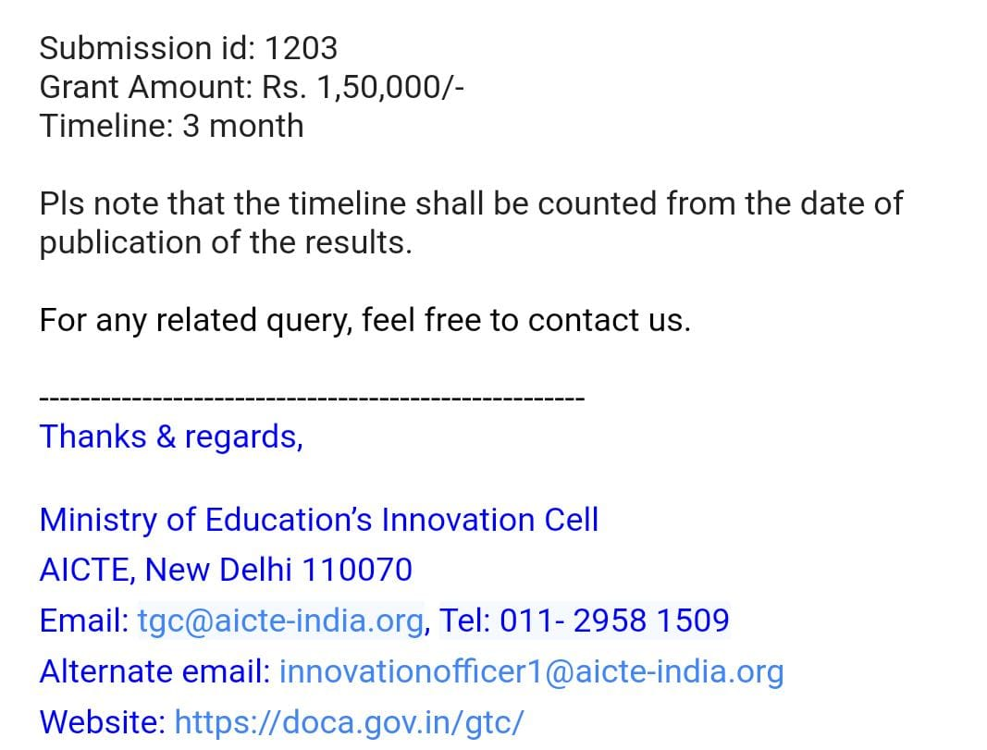
Have you got any other funding support?
Use Images / Photos / Video | Don’t just answer given points in slides | Avoid para | Use bullet points

Slide 16
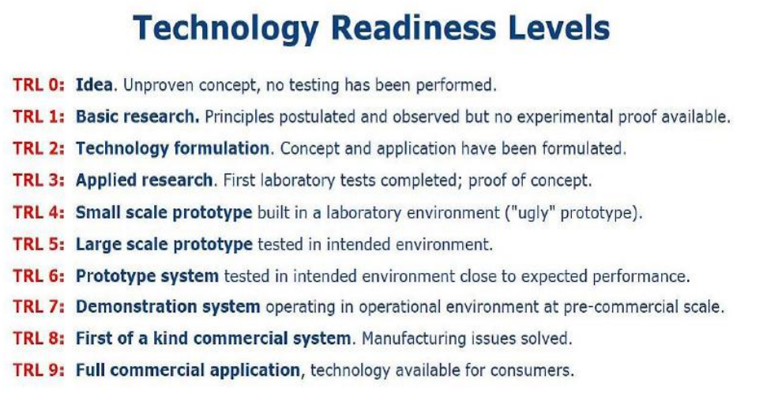
Reference Details

Slide 17
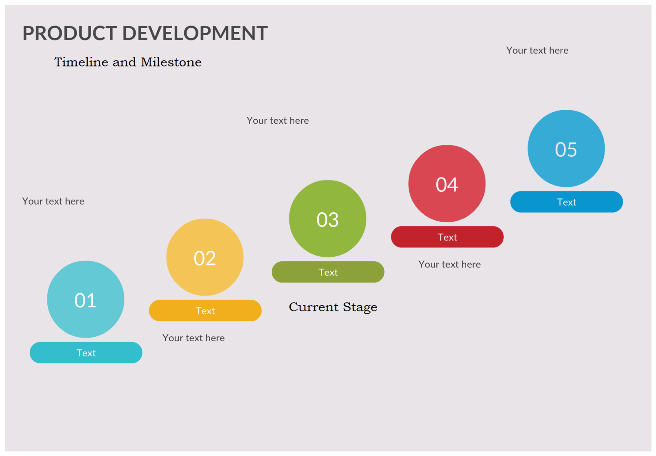
Reference Details

Slide 18
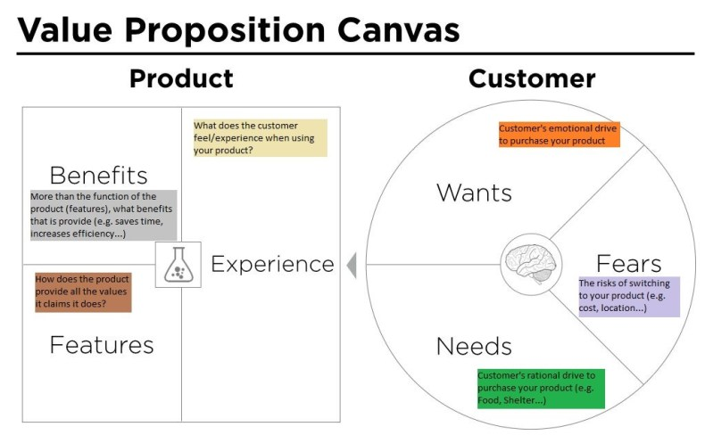
Reference Details

